Slide 1


Tackling Climate Change with AI
Marcus Voß
Birds on Mars & TU Berlin
Climate Change AI

Slide 2
Climate Change, so how bad is it?

Slide 3

Notes:
Annual global temperatures from 1850-2017
The colour scale represents the change in global temperatures covering 1.35°C
http://www.climate-lab-book.ac.uk/2018/warming-stripes/

Slide 4
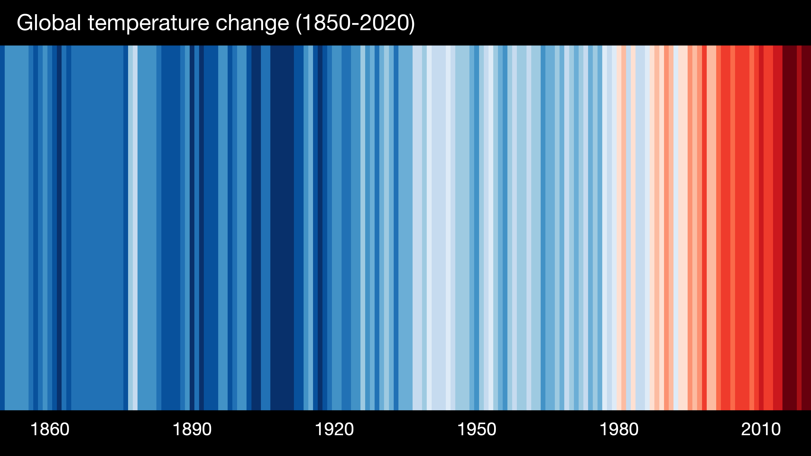
Notes:
Annual global temperatures from 1850-2017
The colour scale represents the change in global temperatures covering 1.35°C
http://www.climate-lab-book.ac.uk/2018/warming-stripes/

Slide 5
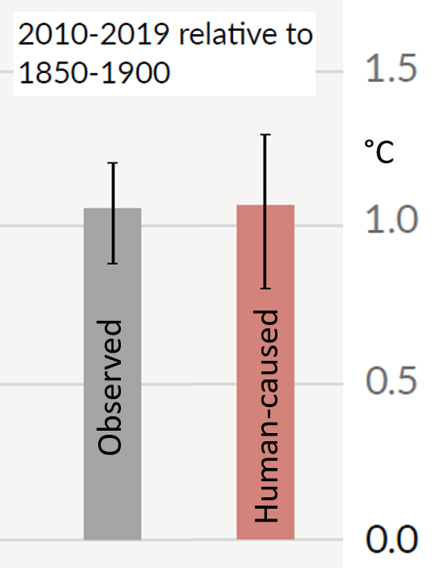
It is estimated that human activities have caused global warming of over 1.0 °C since 1850.
Source: IPCC 6th Assessment Report, 2021, Summary for Policy Makers.

Slide 6
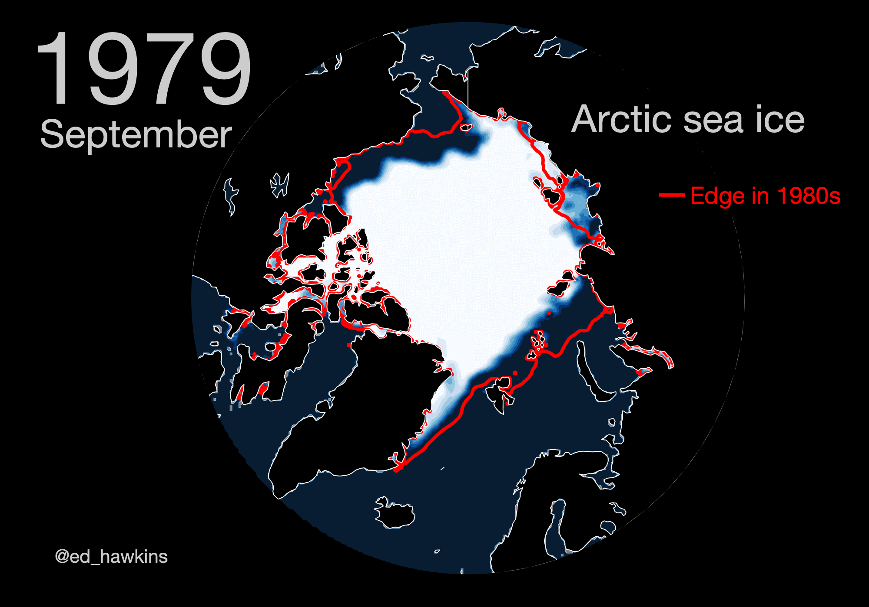
Human-induced climate change is already having an impact on many weather and climate extremes in all regions of the world.
Source: https://github.com/ed-hawkins/climate-visuals

Slide 7

Global surface temperature will continue to rise until at least 2050 under all emissions scenarios
Source: https://github.com/ed-hawkins/climate-visuals

Slide 8
Where can AI and Data Science help tackling climate change?

Slide 9
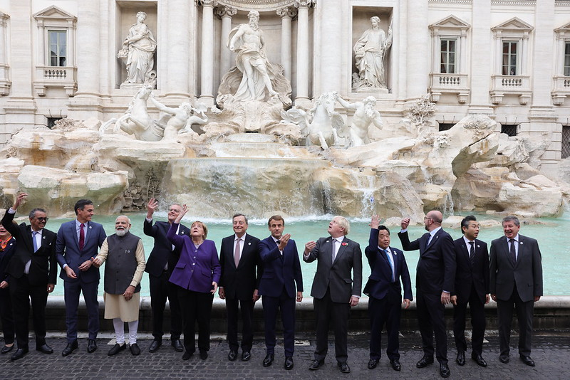
Picture by Andrew Parsons, from: https://www.flickr.com/photos/number10gov/51644289284/in/photostream/
Notes:
Picture by Andrew Parsons, from: https://www.flickr.com/photos/number10gov/51644289284/in/photostream/

Slide 10
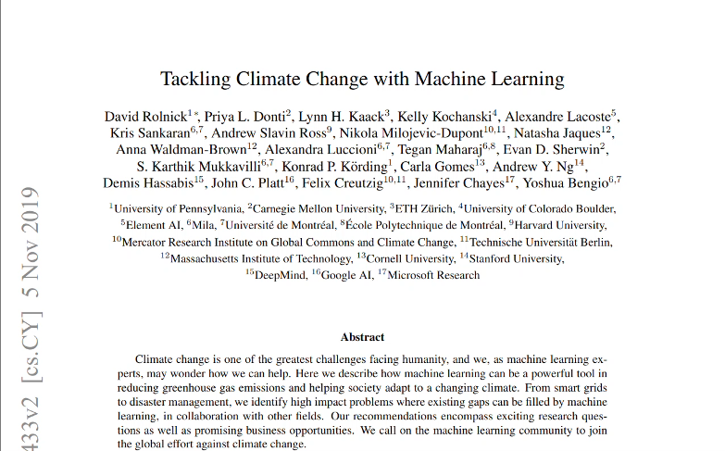
Read the paper: https://arxiv.org/pdf/1906.05433.pdf

Slide 11
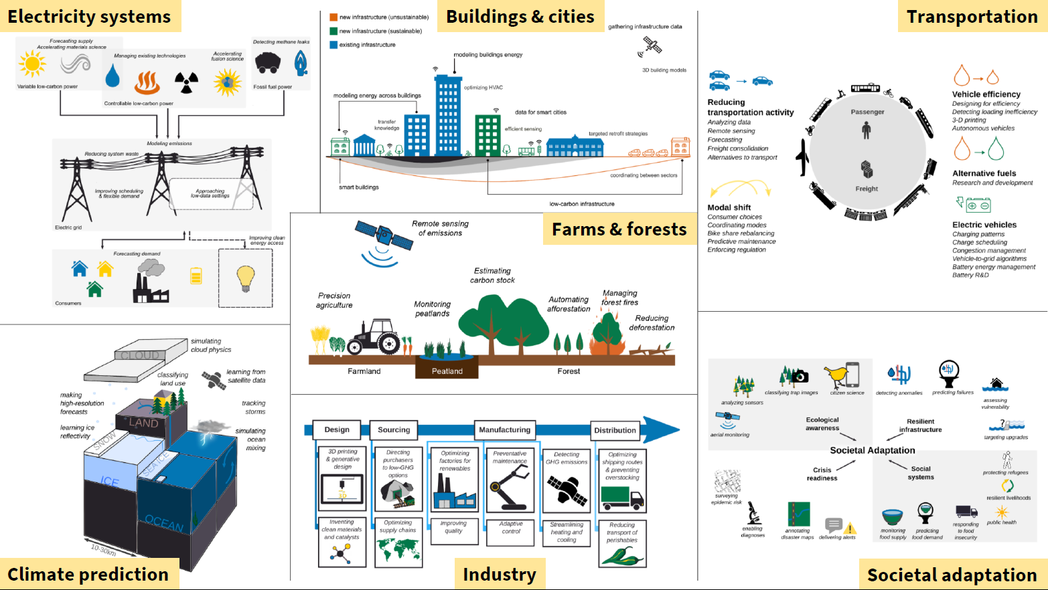

Slide 12
Recurring themes
Forecasting (solar power, extreme events, carbon prices)
Remote sensing (emissions, infrastructure data, deforestation)
Optimizing systems (precision agriculture, heating and cooling)
Approximating time-intensive simulations (climate, energy)
Accelerated experimentation (batteries, nuclear fusion)
Data mining & generation (disaster response, urban planning)
Predictive maintenance (natural gas pipelines, resilient infrastructure)

Slide 13
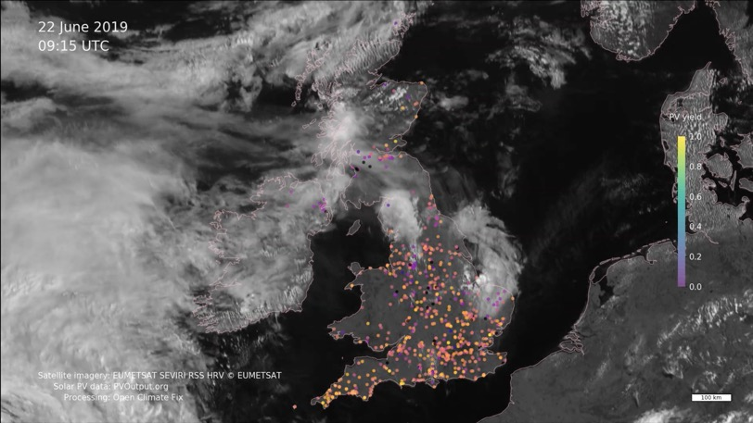
Forecasting
Example: Nowcasting of renewable generation
Motivation: Solar and wind energy vary greatly depending on factors such as weather.
Use case: Predicting power generation to support stable operation of power grids.
AI: Time series algorithms can learn pattern from historical data and weather data.
Image: Open Climate Fix

Slide 14
Recurring themes
Forecasting (solar power, extreme events, carbon prices)
Remote sensing (emissions, infrastructure data, deforestation)
Optimizing systems (precision agriculture, heating and cooling)
Approximating time-intensive simulations (climate, energy)
Accelerated experimentation (batteries, nuclear fusion)
Data mining & generation (disaster response, urban planning)
Predictive maintenance (natural gas pipelines, resilient infrastructure)

Slide 15
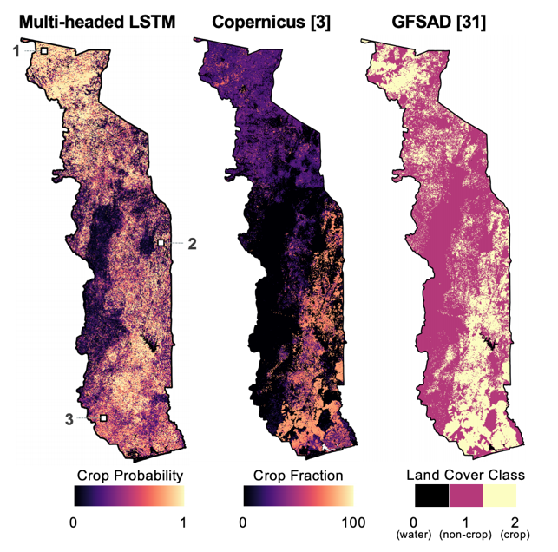
Remote sensing Example: Improving food security
Motivation: Impact of climate change on agriculture (droughts, excessive rainfall, pests).
Use case: Monitoring yields using satellite and aerial imagery.
AI: Computer vision, e.g. for automatic crop detection in a large area.
Image: Kerner, Hannah, et al. "Rapid response crop maps in data sparse regions." arXiv preprint arXiv:2006.16866 (2020).

Slide 16
Recurring themes
Forecasting (solar power, extreme events, carbon prices)
Remote sensing (emissions, infrastructure data, deforestation)
Optimizing systems (precision agriculture, heating and cooling)
Accelerated experimentation (batteries, nuclear fusion)
Approximating time-intensive simulations (climate, energy)
Data mining & generation (disaster response, urban planning)
Predictive maintenance (natural gas pipelines, resilient infrastructure)

Slide 17
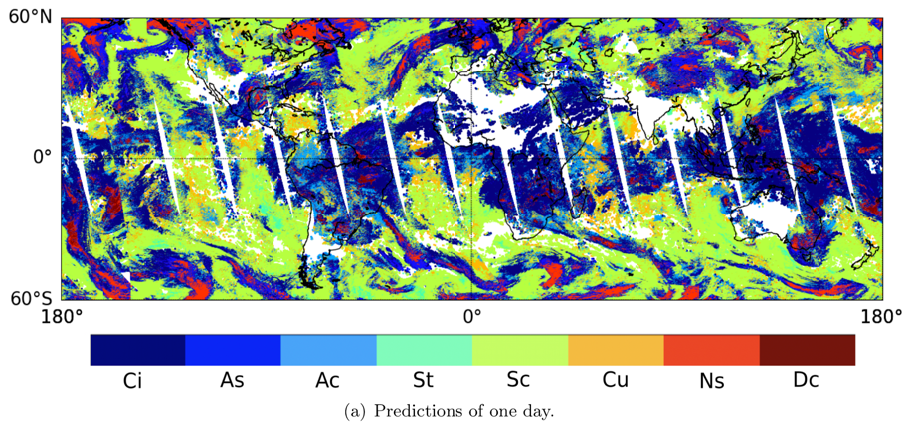
Approximating time-intensive simulations Example: Local Climate Model
Motivation: Modeling of climate and its changes (e.g. atmospheric and ocean physics).
Use case: Accelerate simulations to enable higher spatial or temporal resolution.
AI: Learn patterns in simulated behavior to approximate it.
Zantedeschi, Valentina, et al. "Cumulo: A dataset for learning cloud classes." arXiv preprint arXiv:1911.04227 (2019).

Slide 18
Recurring themes
Forecasting (solar power, extreme events, carbon prices)
Remote sensing (emissions, infrastructure data, deforestation)
Optimizing systems (precision agriculture, heating and cooling)
Approximating time-intensive simulations (climate, energy)
Accelerated experimentation (batteries, nuclear fusion)
Data mining & generation (disaster response, urban planning)
Predictive maintenance (natural gas pipelines, resilient infrastructure)

Slide 19
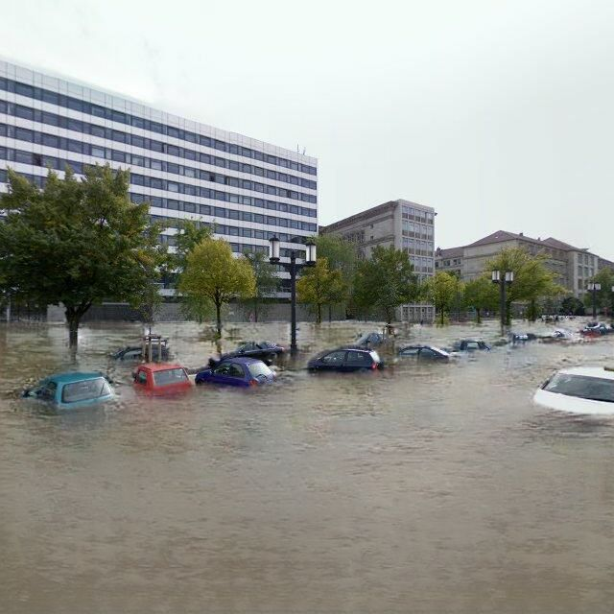
Data Generation Example: https://thisclimatedoesnotexist.com/
Motivation: Climate change impacts seem far away for many people.
Use case: Generate synthetic climate change impacts on Google Earth to increase awareness.
AI: Generative models learn patterns from real data on disasters and combine them with real images.

Slide 20

Data Generation Example: https://thisclimatedoesnotexist.com/
Motivation: Climate change impacts seem far away for many people.
Use case: Generate synthetic climate change impacts on Google Earth to increase awareness.
AI: Generative models learn patterns from real data on disasters and combine them with real images.

Slide 21
Recurring themes
Forecasting (solar power, extreme events, carbon prices)
Remote sensing (emissions, infrastructure data, deforestation)
Optimizing systems (precision agriculture, heating and cooling)
Approximating time-intensive simulations (climate, energy)
Accelerated experimentation (batteries, nuclear fusion)
Data mining & generation (disaster response, urban planning)
Predictive maintenance (natural gas pipelines, resilient infrastructure)

Slide 22
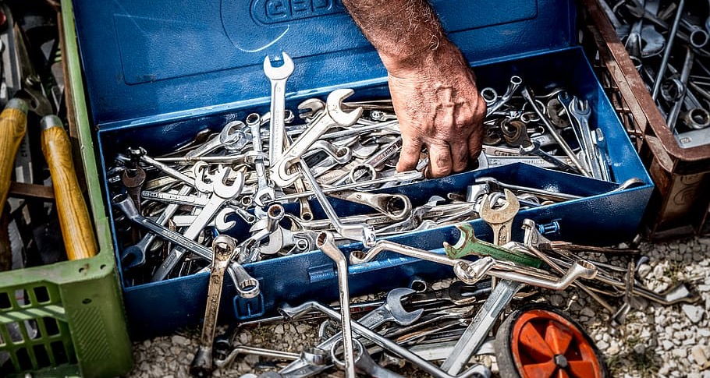
Image: https://www.piqsels.com/de/public-domain-photo-onevo/

Slide 23
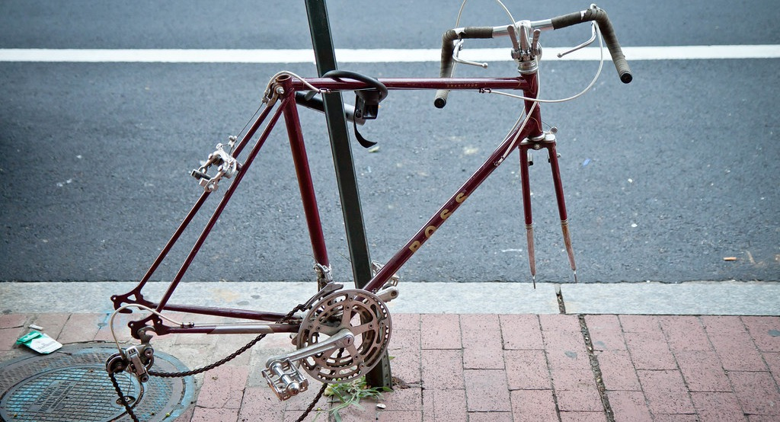
Image: https://www.flickr.com/photos/ep_jhu/4770392109/

Slide 24
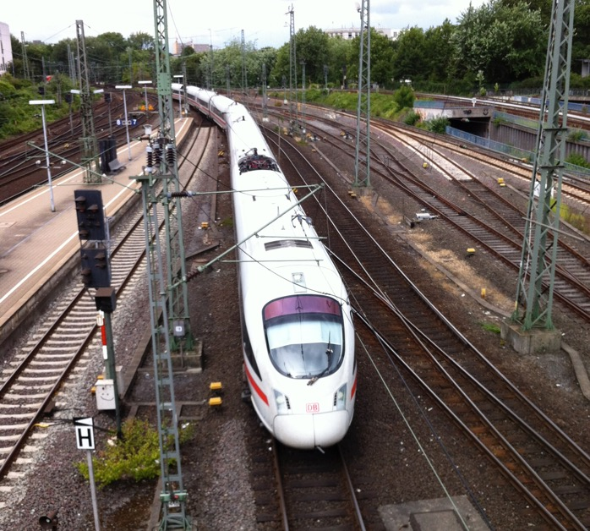
Predictive maintenance Example: Deutsche Bahn
Motivation: To make operation more efficient, more cost-effective and less error-prone.
Use case: Deutsche Bahn uses this in the operation of railroad facilities, e.g. for the maintenance of track switches.
AI: Analysis of measurement data to detect deviations and predict maintenance needs.
Image: Wikicommons

Slide 25
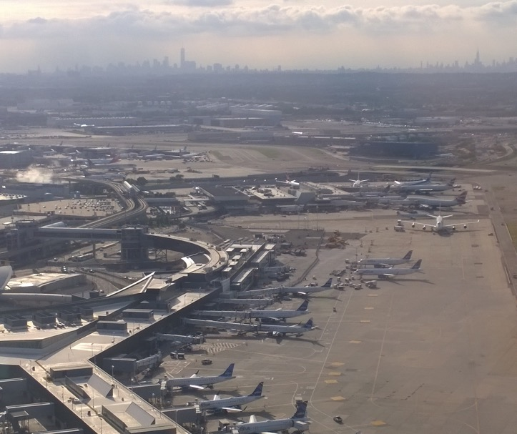
Predictive maintenance Example: Airport
Motivation: To make operation more efficient, more cost-effective and less error-prone.
Use case: Airports uses this in the operation, e.g. for the maintenance of baggage handling systems, elevators and escalators.
AI: Analysis of measurement data to detect deviations and predict maintenance needs.
Image: Wikicommons

Slide 26

Important considerations
ML/AI/Data Science are powerful tools and are on its own not good or bad for climate.
ML is not a silver bullet! Not applicable everywhere.
Notes:
team up: whole greater than sum of parts, new ideas
And this is how machine learning applications are often developed in practice
Jevons: If things are more efficient, it will get used more
Equity: ML gets developed to interact with the richest people
Partners: need the domain expert and end users on the ground to have an impactful project
Collaborate with others with different perspectives
Listen to what collaborators/stakeholders say is needed (be humble!)

Slide 27
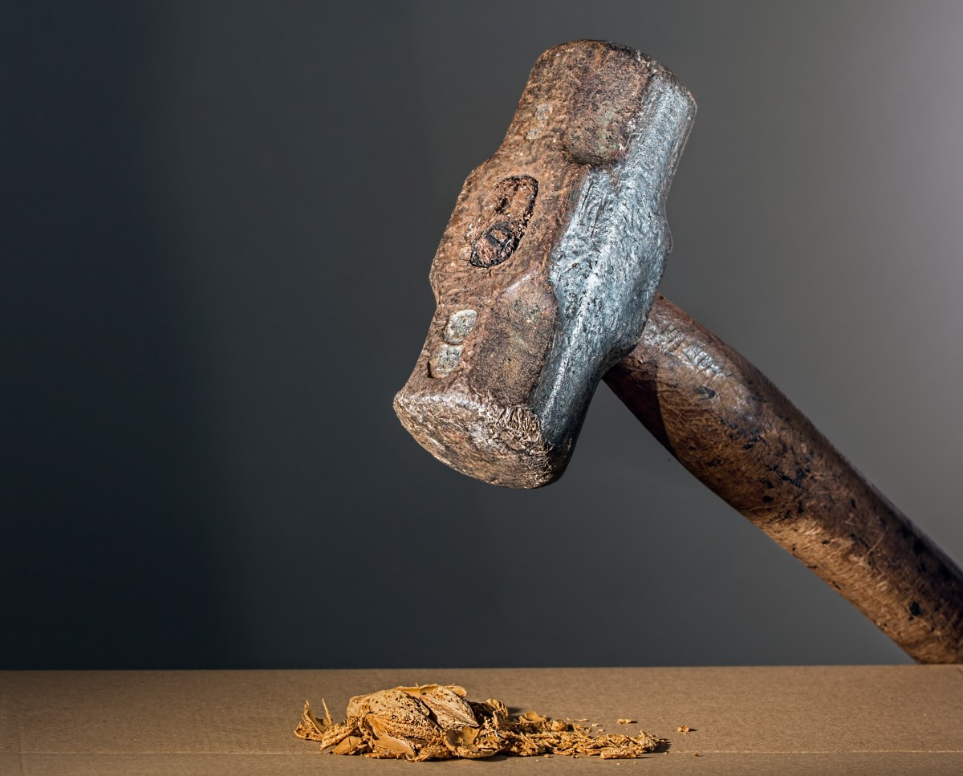
Image: https://pxhere.com/en/photo/895059

Slide 28

Image: Tim Reckmann (https://ccnull.de/foto/walnuss-im-nussknacker/1002529)

Slide 29
Important considerations
ML/AI/Data Science are powerful tools and are on its own not good or bad for climate.
ML is not a silver bullet! Not applicable everywhere.
Where applicable, only one part of the strategy
Notes:
team up: whole greater than sum of parts, new ideas
And this is how machine learning applications are often developed in practice
Jevons: If things are more efficient, it will get used more
Equity: ML gets developed to interact with the richest people
Partners: need the domain expert and end users on the ground to have an impactful project
Collaborate with others with different perspectives
Listen to what collaborators/stakeholders say is needed (be humble!)

Slide 30
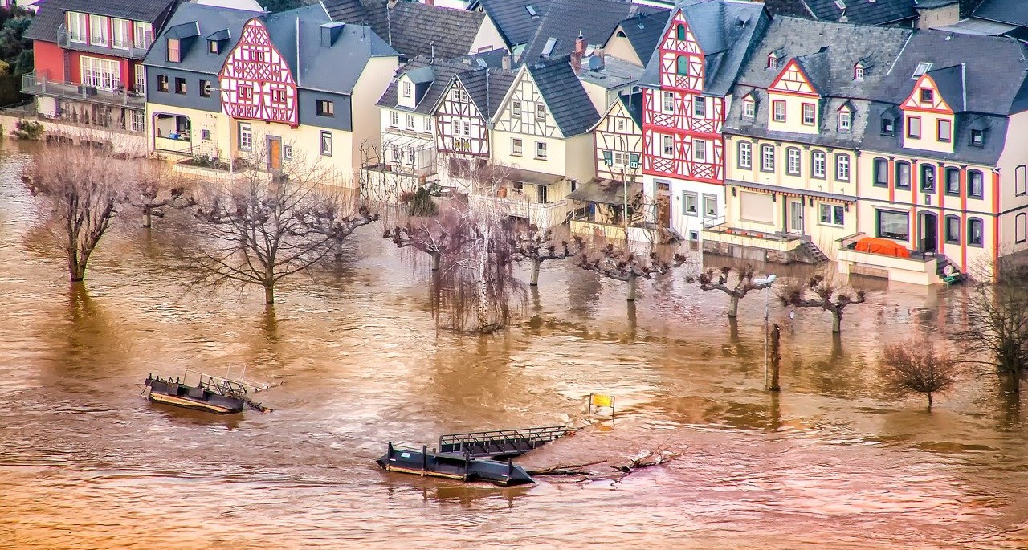
Image: https://pixabay.com/de/photos/hochwasser-rhein-rheinland-pfalz-3291249/

Slide 31
Important considerations
ML/AI/Data Science are powerful tools and are on its own not good or bad for climate.
ML is not a silver bullet! Not applicable everywhere.
Where applicable, only one part of the strategy
Work needs to be driven by relevant stakeholders, collaboration is key to doing meaningful work.
Notes:
team up: whole greater than sum of parts, new ideas
And this is how machine learning applications are often developed in practice
Jevons: If things are more efficient, it will get used more
Equity: ML gets developed to interact with the richest people
Partners: need the domain expert and end users on the ground to have an impactful project
Collaborate with others with different perspectives
Listen to what collaborators/stakeholders say is needed (be humble!)

Slide 32
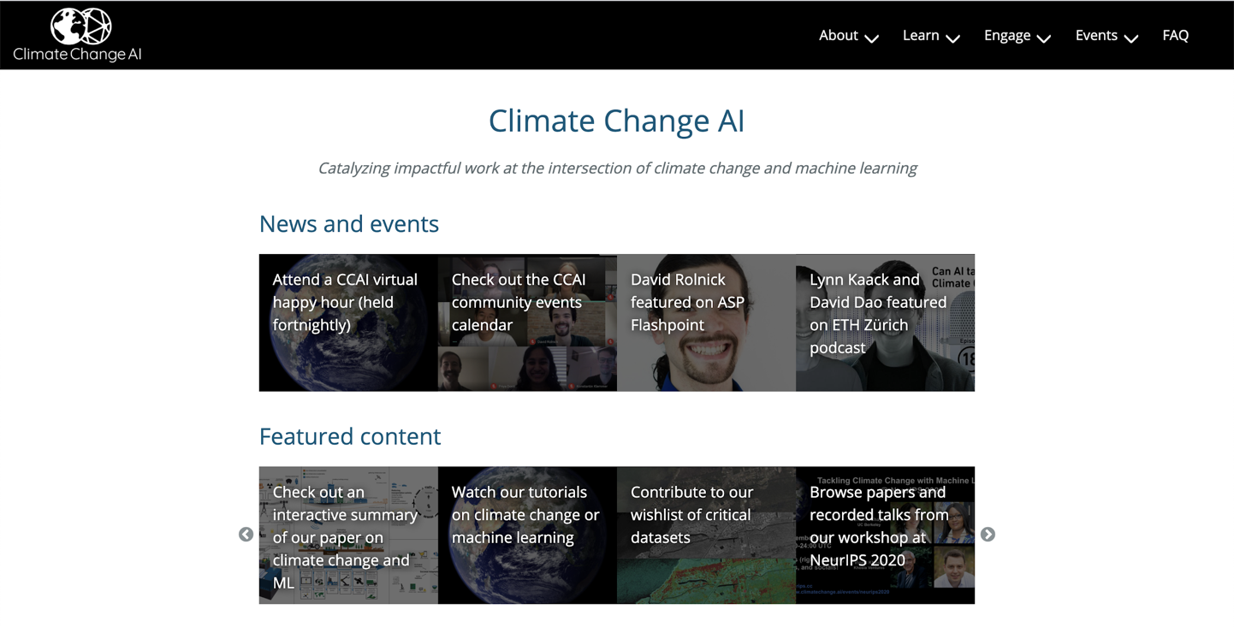
Climate Change AI
An initiative to facilitate work in climate change and machine learning
https://www.climatechange.ai/

Slide 33







Stay updated! CCAI Newsletter
Calls for Submissions Funding Projects & Courses
Readings Jobs
Sign-up: https://www.climatechange.ai/newsletter

Slide 34
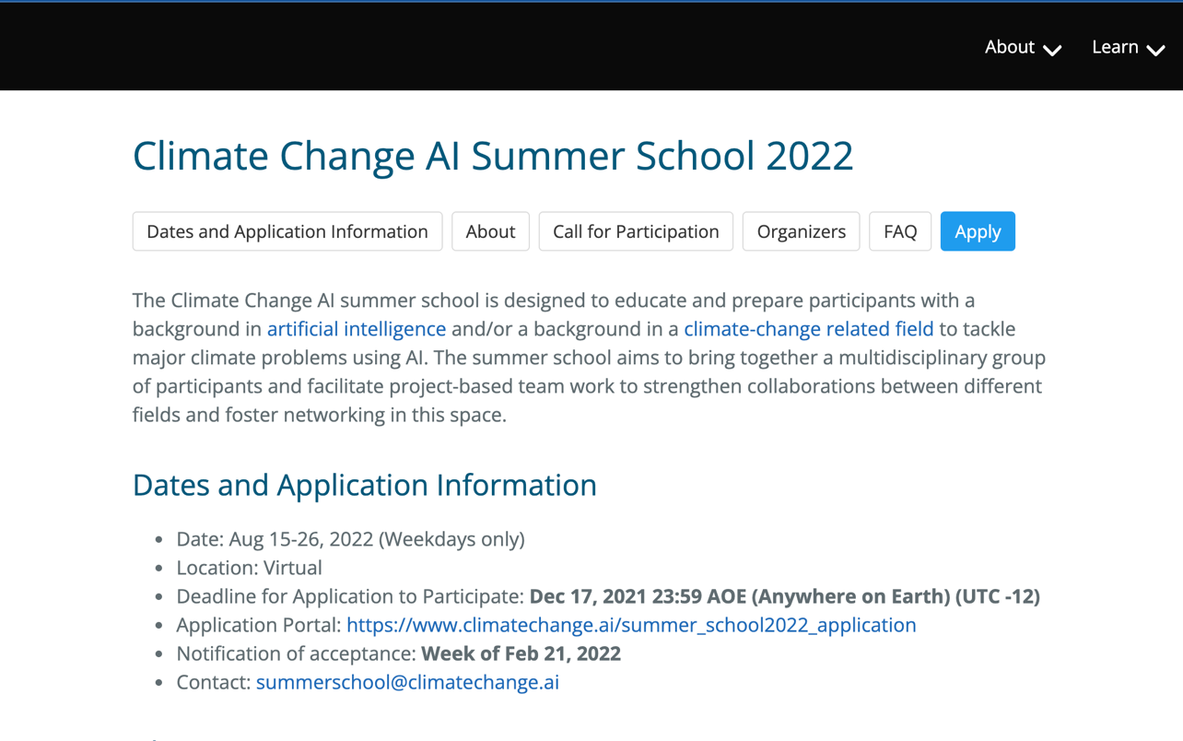
Climate Change AI Summer School 2022
Apply (until 17.12.): https://www.climatechange.ai/events/summer_school2022/

Slide 35
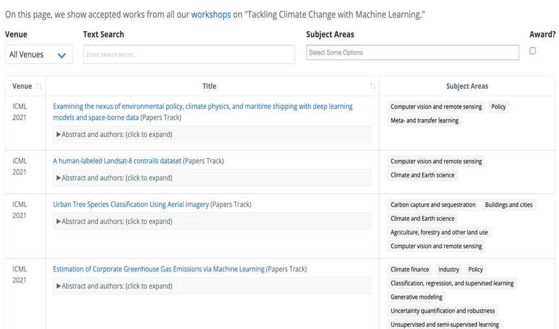
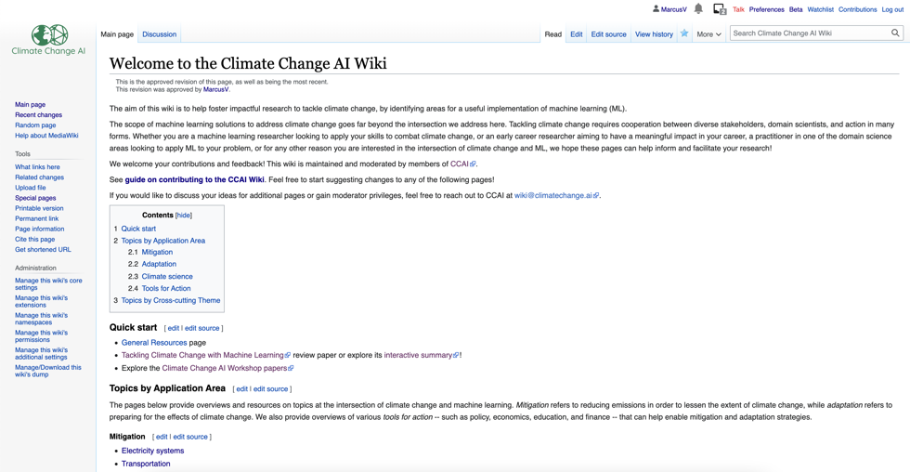
Paper search made easy
Ressource Wiki
https://www.climatechange.ai/papers
https://wiki.climatechange.ai/

Slide 36
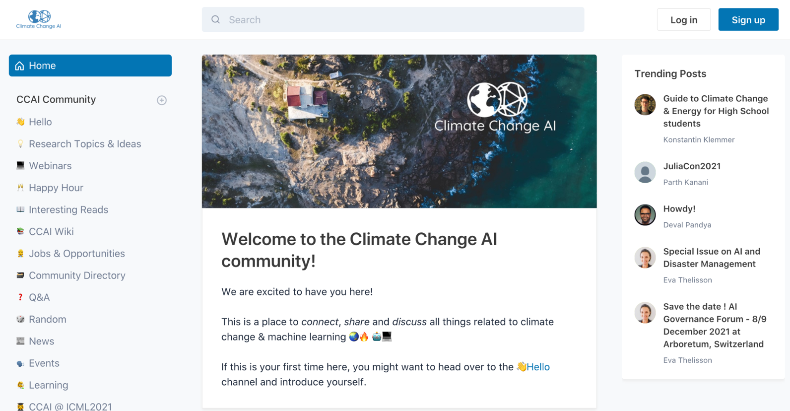
Connect with the wider community!
Join us: https://community.climatechange.ai/

Slide 37
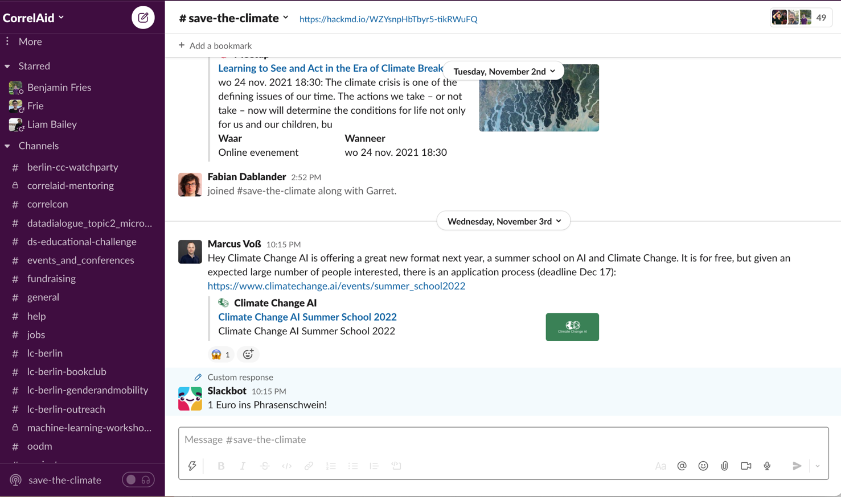
Join #save-the-climate on CorreAid Slack

Slide 38

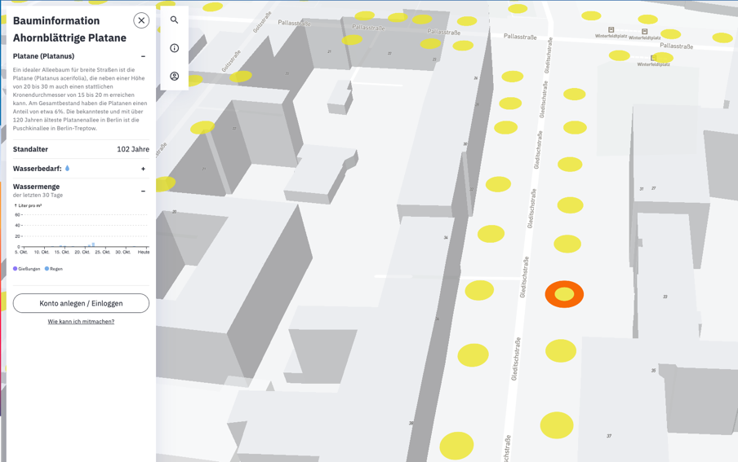

Berlin-based Project: Q-Trees
AI for Climate Change Adpation of Urban Trees
Check out (in a few weeks): https://qtrees.ai/

Slide 39

Thanks!
www.climatechange.ai
@ClimateChangeAI

